Slide 1

Practical Training Seminar
on
“COLOUR BLINDNESS CORRECTION”
Presented By:
Akshay Sharma
16EJCCS019
CSE/Btech-VII sem/A1
Submitted To:
Dr, Vijeta Kumawat
Dr. Sanjay Gaur
HOD, CSE

Slide 2
OBJECTIVE
Color vision deficiency affects 8% men and one in every 200 women.
There are many different types of color blindness with the red-green as the most common.
Most models for color correction are based on physiological models of how people with color vision deficiency perceive the world, with the goal of reducing errors derived from the color blindness simulation formula.

Slide 3
INTRODUCTION TO OUR PROJECT
In this paper we present Deep Correct, a novel Deep Learning based method for color correcting images in order to improve accessibility for people with color vision deficiency. The key elements of this work with regard to color blindness are two fold:
1) we propose a data-driven Deep Learning approach for color correction.
2) we create an objective, quantitative metric for determining the distinguishability of images.

Slide 4
MAJOR TECHNOLOGY USED
We have majorly used deep learning for this project.
Similar to machine learning, deep learning also has supervised, unsupervised, and reinforcement learning in it.
Deep learning was inspired by artificial neural networks and artificial neural networks commonly known as ANN were inspired by human biological neural networks.
Deep learning is one of the ways of executing machine learning.

Slide 5
NEURAL NETWORKS
A neural network will always have:
Input layer: It can be pixels of an image or a time series data.
Hidden layer: Commonly known as weights which are learned while the neural network is trained.
Output layer: Final layer mainly gives you a prediction of the input you fed into your network.

Slide 6
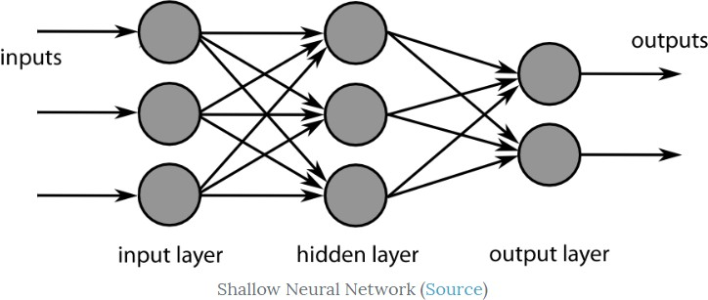
DIAGRAM OF A NEURAL NETWORK

Slide 7
TYPES OF NEURAL NETWORK
Convolutional Neural Network,
Recurrent Neural Network,
Auto Encoders
Long short-term memory,
Sparse autoencoder
Denoising autoencoder
Stacked autoencoder
Variational autoencoder

Slide 8
CONVOLUTIONAL NEURAL NETWORK
We have majorly used convolutional neural network to train our data that included images of various colors categorized as red, green, yellow and others.
Various colours used in CNN are :-
Sequential
Convolution 2D
Max Pooling 2D
Flatten
Dense

Slide 9
WORKFLOW OF THE PROJECT
We initial have a dataset of images containing different colours.
We preprocess our data to separate out the image into its own label.
Finally, we get four labels of red, green, yellow and others.
We train our convolutional neural network on the basis of this data set.
We store our trained model into a file with .hs extension.

Slide 10
6. Now we use this model to convert our live pictures into some different colour.
7. For eg. If I am colour blind to yellow colour I change it to red.
8. We use OpenCV to capture live recordings for our project.
9. The screens captured through our camera becomes our testing set.

Slide 11
FUTURE SCOPE
We can make a menu-driven program and can further make it for each colour.
We can use it in real life by combing this process with IoT. So that a device can be formed which further can be used in specs/lens for a colour blind person.
It can also be further increased by taking a large dataset with all shades of different colour and can enhance it in a more better way.

Slide 12
CONCLUSION
The given challenge or experiment provide the major knowledge into deep learning and machine learning techniques.
It gives accuracy which is always helpful towards medical science.
After implementing numerous methods, model and the dice coefficient we found one proper trained model which can be used for further references.

Slide 13
THANK YOU

